Slide 1
CHAPTER 10: Tree
Tree data structure is a collection of data (Node) which is organized in hierarchical structure and this is a recursive definition
In a tree data structure, if we have N number of nodes then we can have a maximum of N-1 number of links.

Slide 2
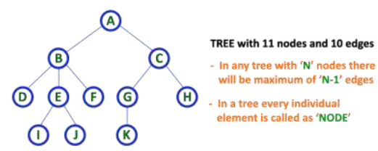
Example tree represenatriom
Tree representation

Slide 3
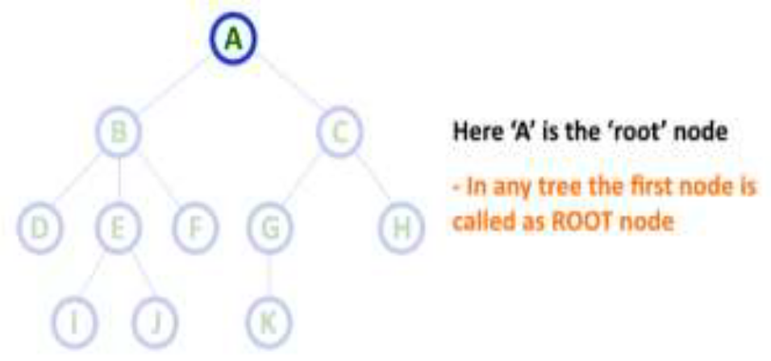
Tree Terminology
In a tree data structure, we use the following terminology:
a. Root
In a tree data structure, the first node is called as Root Node. Every tree must have root node..

Slide 4
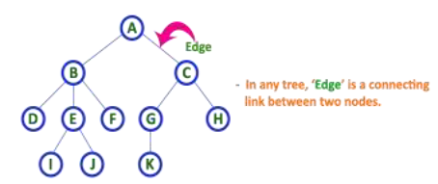
b. Edge
In a tree data structure, the connecting link between any two nodes is called an Edge. In a tree with 'N' number of nodes there will be a maximum of 'N-1' number of edges.

Slide 5
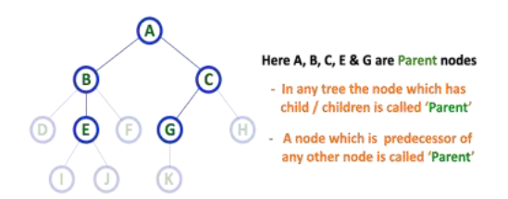
c. Parent
In a tree data structure, the node which is predecessor of any node is called a PARENT NODE.
In simple words, the node which has branch from it to any other node is called
as parent node.

Slide 6
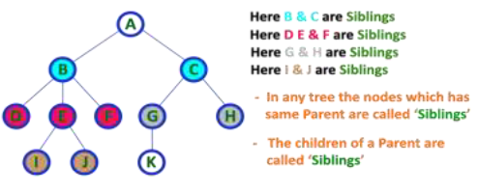
e. Siblings
In a tree data structure, nodes which belong to same Parent are called SIBLINGS.

Slide 7
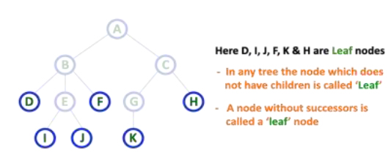
f. Leaf
In a tree data structure, the node which does not have a child is called a LEAF Node.
In a tree data structure, the leaf nodes are also called a External Nodes or Terminal node.

Slide 8
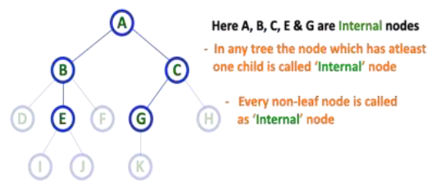
Internal Nodes
In a tree data structure, the node which has at least one child is called INTERNAL Node.
In a tree data structure, nodes other than leaf nodes are called Internal Nodes. The root node is
also said to be Internal Node if the tree has more than one node. Internal nodes are also called as
'Non-Terminal' nodes.

Slide 9
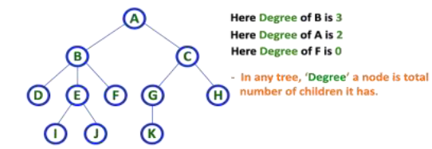
Degree
In a tree data structure, the total number of children of a node is called as DEGREE of that Node.
In simple words, the Degree of a node is total number of children it has. The highest degree of a
node among all the nodes in a tree is called as 'Degree of Tree'

Slide 10
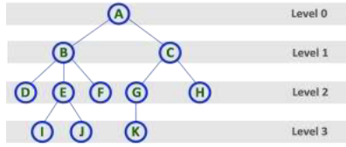
Level
In a tree data structure, the root node is said to be at Level 0 and the children of root node are at
Level 1 and the children of the nodes which are at Level 1 will be at Level 2 and so on... In simple
words, in a tree each step from top to bottom is called as a Level and the Level count starts with
'0' and incremented by one at each level (Step).

Slide 11
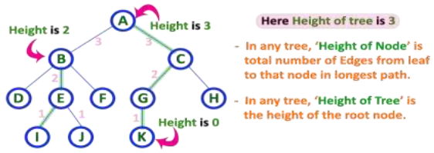
Height
In a tree data structure, the total number of edges from leaf node to a particular node in the longest
path is called as HEIGHT of that Node. In a tree, height of the root node is said to be height of
the tree. In a tree, height of all leaf nodes is '0'.

Slide 12
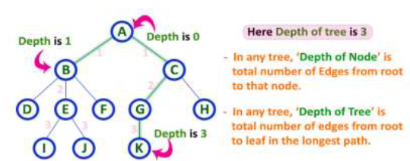
Depth
In a tree data structure, the total number of edges from root node to a particular node is
called DEPTH of that Node. In a tree, the total number of edges from root node to a leaf node in the longest path is said to be Depth of the tree. In a tree, depth of the root node is '0'.

Slide 13
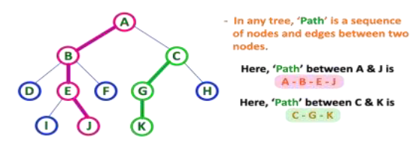
Path
In a tree data structure, the sequence of Nodes and Edges from one node to another node is called
as PATH between those two Nodes. Length of a Path is total number of nodes in that path. In below example the path A - B - E - J has length 4.

Slide 14
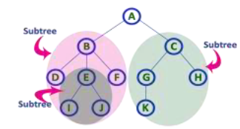
Sub Tree
In a tree data structure, each child from a node forms a sub tree recursively. Every child node will form a sub-tree on its parent node.

Slide 15
Binary Tree Representations
A binary tree data structure is represented using two methods. Those methods are as follows...
Linked List of Binary Tree representation
Array Representation
Let T be a Binary Tree. There are two ways of representing T in the memory as follow Linked

Slide 16
a) Linked List of Binary Tree representation
Consider a Binary Tree T. T will be maintained in memory by means of a linked list representation, which uses three parallel arrays; INFO, LEFT, and RIGHT pointer variable ROOT as follows. In Binary Tree, each node N of T will correspond to a location k such that:
1. LEFT [k] contains the location of the left child of node N.
2. INFO [k] contains the data at the node N.
3. RIGHT [k] contains the location of right child of node N.

Slide 17

Representation of a node:
In this representation of binary tree, root will contain the location of the root R of T. If any one of the sub tree is empty, then the corresponding pointer will contain the null value if the tree T itself is empty, the ROOT will contain the null value.

Slide 18
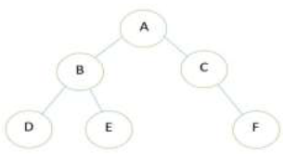
Example
Consider the binary tree T in the figure of Binary Tree

Slide 19
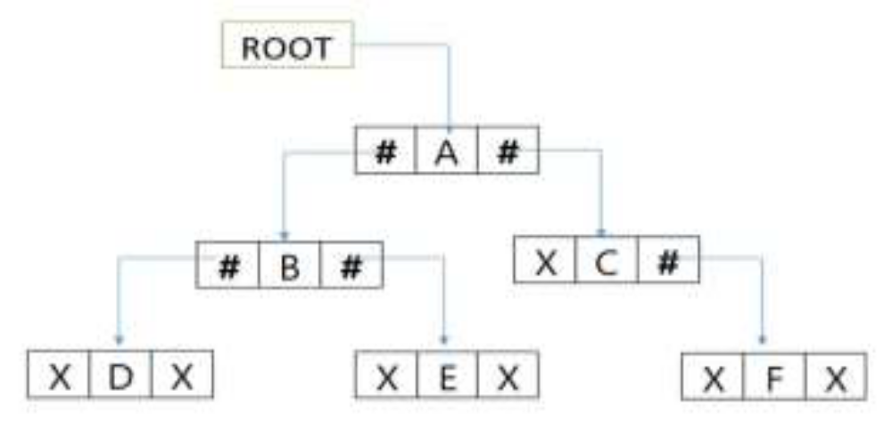
Linked Representation of the Binary Tree

Slide 20
b. Array Representation of Binary Tree
Let us consider that we have a tree T. let our tree T is a binary tree that us complete binary tree.
Then there is an efficient way of representing T in the memory called the sequential representation or array representation of T

Slide 21
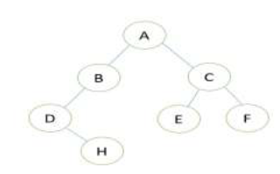
For Example:
Its sequential representation is as follow:

Slide 22
Binary Tree Traversals
When we wanted to display a binary tree, we need to follow some order in which all the nodes of that binary tree must be displayed. In any binary tree displaying order of nodes depends on the traversal method.

Slide 23
Types of binary tree traversals.
In - Order Traversal
Pre - Order Traversal
Post - Order Traversal
BFS(by level) traversal
Traversal is a process to visit all the nodes of a tree and may print their values too. Because, all nodes are connected via edges (links) we always start from the root (head) node. That is, we cannot randomly access a node in a tree.

Slide 24
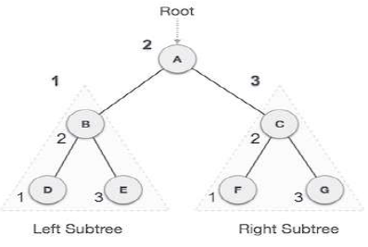
a. In-order Traversal
In this traversal method, the left sub tree is visited first, then the root and later the right sub-tree. We should always remember that every node may represent a sub tree itself.
If a binary tree is traversed in-order, the output will produce sorted key values in an ascending order.

Slide 25
In order traversal cont’d
We start from A, and following in-order traversal, we move to its left subtree B.
B is also traversed in-order. The process goes on until all the nodes are visited.
The output of in order traversal of this tree will be
D → B → E → A → F → C → G

Slide 26
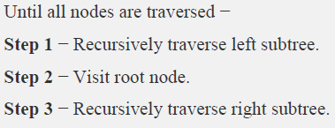
Algorithm

Slide 27
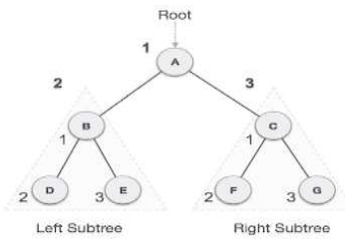
b. Pre-order Traversal
In this traversal method, the root node is visited first, then the left subtree and finally the right subtree.
We start from A, and following pre-order traversal, we first visit A itself and then move to its left subtree B. B is also traversed pre-order. The process goes on until all the nodes are visited.
The output of pre-order traversal of this tree will be −
A → B → D → E → C → F → G

Slide 28
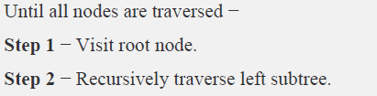
Algorithm

Slide 29
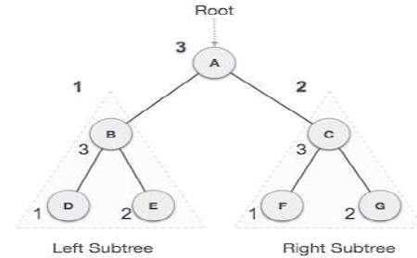
Post-order Traversal
In this traversal method, the root node is visited last, hence the name. First we traverse the left sub tree, then the right sub tree and finally the root node.
We start from A, and following Post-order traversal, we first visit the left sub tree B. B is also traversed post-order. The process goes on until all the nodes are visited.
The output of post-order traversal of this tree will be −
D → E → B → F → G → C → A

Slide 30
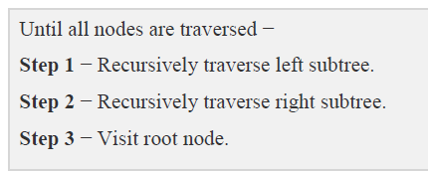
Algorithm

Slide 31
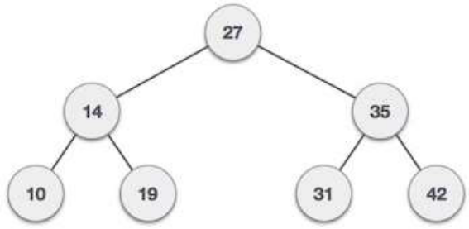
Exercises
Traverse the following tree using:
In order traversal
Pre order traversal
Post order traversal
BFS order traversal

Slide 32
End

